Slide 1



Individual Placement and Support
beyond severe mental illness (IPS beyond SMI):
An overview review of the quantitative evidence around vocational outcomes and impacts
Prof Adam Whitworth
Scottish Centre for Employment Research
Strathclyde Business School
University of Strathclyde
adam.whitworth@strath.ac.uk
X THE PLACE OF USEFUL LEARNING

Slide 2





Project overview
National Institute for Health and Care Research (NIHR) funding running Apr 2022 – March 2024
The project’s starting point:
Supported Employment (by which we mean IPS & SEQF) is innovating beyond severe mental illness in different cohorts and settings
UK trialling & expansion has been at the forefront of that innovation
Right time to reflect critically on these UK experiences and advance new questions and insights to inform and support IPS & supported employment beyond severe mental illness in future
Applied research with strong external partner engagement & commitment to impact alongside new research learnings

Slide 3
Research aims & work packages
1. To review the international experience and evidence of Supported Employment beyond severe mental illness (WP1 – systematic review)
2. To transform understanding of Supported Employment beyond severe mental illness in design & implementation to support future effectiveness, cost-efficiency, experiences and equity (WP2 – quali interviews with 80+ providers, clients, commissioners, co-location partners, employers coming…)
3. To understand the costs and cost-benefits of alternative Supported Employment beyond severe mental illness scenarios and to build new open source cost-benefit tools for wider use (WP3)
4. To maximise applied impacts through a Toolkit of practical resources to support commissioners and providers in future

Slide 4
WP1: Systematic review
Why? Policy & evidence around SE beyond severe mental illness is rapidly evolving and fragmented. We want to provide a comprehensive and consolidated review of the key evidence.
Particular interests in the review:
  Interventions: What different types of interventions, locations, size, population groups, settings, fidelity
  Outcomes and impacts (vocational, health and wider)
  Key contextual factors
  Costs and cost-benefits
  Inclusive approach: qualitative & quantitative & non-RCT evidence are all in scope, as is grey as well as peer-reviewed literature
  Two key analysis strands and outputs to date in WP1:
  Overview review of evidence around vocational outcomes (e.g. job entry, sustainment, wages, hours)
  Qualitative evidence synthesis: key contextual factors to SE service performance

Slide 5
Search criteria
Intervention participants | Individuals without severe mental health difficulties
Type of intervention | IPS or SE employment programmes – operating to IPS or SEQF fidelity (or, given SEQF existing only since 2017, following the SEQF model and values but not the formal SEQF fidelity scale per se)
Study design | Any for the search; counterfactual required for inclusion in this overview review
Publication type | Peer-reviewed or grey literature
Outcomes | Any effect including relating to employment, quality of life, health or wellbeing or any views or perceptions of programme success factors, barriers or programme implementation
Date | Published since 2000
Countries | Any high-income or upper-middle-income nation as defined by the World Bank Atlas method
Language | Published in English

Slide 6
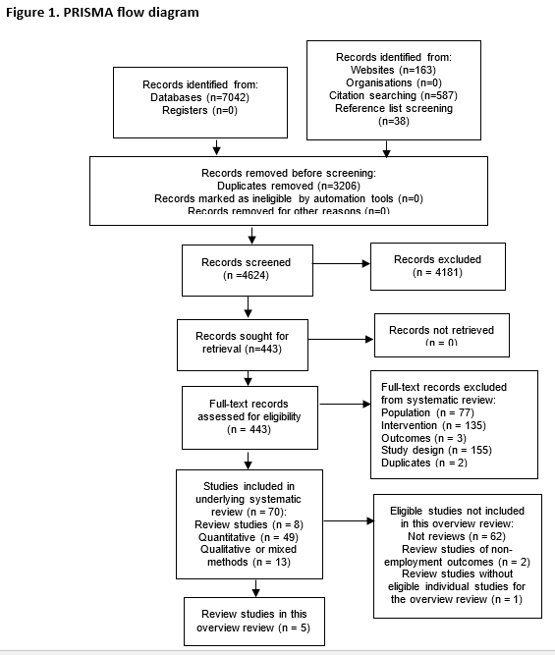
PRISMA flow diagram

Slide 7
5 existing eligible reviews & 18 eligible IPS studies by population group
 | Bond et al (2019) | Fadyl et al (2020) | Probyn et al (2021) | Harrison et al (2020) | Jetha et al (2019) | Additional recent studies
Review Focus / Population Group | RCTs of IPS beyond SMI | RCTs of vocational interventions for mild to moderate mental health | RCTs of SE beyond SMI | Studies of IPS for substance misuse | Studies of vocational interventions for young adults with chronic health conditions
Common mental Health (CMH) | Reme et al (2015) Hellstrom et al (2017) | Reme at al (2015) Hellstrom et al (2017) |  |  |  | Davis et al (2022)
CMH &/or musculoskeletal (MSK) |  |  |  |  |  | Newton et al (2023)
CMH or somatic disorder |  |  |  |  |  | Brinchmann et al (2024)
Moderate to severe mental health | Reme et al (2019) | Reme et al (2019) Poremski et al (2015) | Poremski et al (2015) |  | Ferguson et al (2012)
Affective disorder | Bejerholm et al (2017) | Bejerholm et al (2017) | Bejerholm et al (2017)
PTSD veterans | Davis et al (2012) Davis et al (2018) | Davis et al (2012) Davis et al (2018) | Davis et al (2012)
Substance misuse | Lones et al (2017) LePage et al (2016) |  | Lones et al (2017) LePage et al (2016) | Lones et al (2017) LePage et al (2016) Rosenheck and Mares (2007) |  | Marsden et al (2024)
Spinal cord injury | Ottomanelli et al (2012) |  | Ottomanelli et al (2012)
NEET young adults |  |  | Sveinsdottir et al (2020)
Chronic pain |  |  |  |  |  | Sveinsdottir et al (2022)

Slide 8
Study | Broad Condition/ Population group | Condition/ Population details | Country | Sample Size (t) | Sample size (c) | Intervention | Fidelity Scale | Fidelity Level | Control Group | Method
Reme et al (2015) | Common mental health | Sick leave, at risk of sick leave, long-term disability benefits | Norway | 630 | 563 | IPS + work-focused CBT | IPS | Not reported | List of job resources | RCT
Hellstrom et al (2017) | Common mental health | Mood and anxiety disorders | Denmark | 162 | 164 | Modified IPS (no integration, benefits counselling & minimal job development) | IPS | Not reported but likely low | Non-integrated BAU services | RCT
Davis et al (2022) | Common mental health | Veterans with non-psychotic mental health and primary care link | US | 58 | 61 | IPS | IPS | Fair improved to good | Standard vocational rehabilitation | RCT
Newton et al (2023) | Common mental health &/or physical health | Common mental health and/or physical health in primary care | UK | 4,896 | 4,889 | IPS | IPS | Fair to good | Standard vocational rehabilitation | RCT
Davis et al (2012) | Mild to moderate mental health | Veterans with PTSD | US | 42 | 43 | IPS | IPS | Fair | Compensated work therapy | RCT
Davis et al (2018) | Mild to moderate mental health | Veterans with PTSD | US | 271 | 270 | IPS | IPS | Fair improving to good | Compensated work therapy | RCT
Reme et al (2019) | Moderate to severe mental health | Depression, psychosis, panic disorders, drug/alcohol, bipolar disorder, anxiety | US | 229 | 181 | IPS | IPS | Below fair improved to fair to excellent | Non-integrated BAU services | Multi-site RCT (unbalanced groups)
Poremski et al (2017) | Moderate to severe mental health + housing issues | Homeless or precariously housed 18-24yr olds with major depression, mania or hypomania, PTSD, panic disorder, mood disorder with psychotic features, psychotic disorder | US | 44 | 41 | IPS + Housing First | IPS | Fair improving to good | Non-integrated BAU services | Stratified RCT
Ferguson et al (2012) | Moderate to severe mental health + housing issues | Homeless 18-24yr olds with major depression, generalized anxiety, mania or hypomania, antisocial personality disorder, PTSD, substance misuse | US | 20 | 16 | IPS | IPS | Not reported | Non-integrated BAU services | Non-RCT & unmatched similar service & participants
Bejerholm et al (2017) | Moderate to severe mental health | Affective disorders (depressive episode, recurrent depression, bipolar disorder, mania or hypomania) | Sweden | 33 | 25 | IPS + motivational interviewing + cognitive strategies + structured time-use patterning | IPS | Good | Non-integrated BAU services | RCT
Brinchmann et al (2024) | Common mental health or somatic disorder | Adults 18-40 years old with significantly reduced capacity to work due to medical condition(s), receiving the work assessment allowance benefit and mental health support | Norway | 561 | 3150 | IPS | IPS | Fair to good | Non-integrated BAU | Difference-in-difference estimation

Slide 9
Study | Broad Condition/ Population group | Condition/ Population details | Country | Sample Size (t) | Sample size (c) | Intervention | Fidelity Scale | Fidelity Level | Control Group | Method
LePage et al (2016) | Substance misuse and/or common mental health | Formerly incarcerated veterans with substance issues (88%) and/or mental health issue (59%) of which predominantly depression | US | 46 | 38 | Modified IPS (no integration, larger caseloads, some exclusions, some mandation) | IPS | Fair | Non-integrated BAU services | RCT
Lones et al (2017) | Substance misuse | Opioid misuse | US | 22 | 23 | IPS | IPS | Fair | Non-integrated BAU services | RCT waitlist control group
Marsden et al (2024) | Substance misuse | Opioid, alcohol, cannabis and stimulants | UK | 844 | 843 | IPS | IPS | Fair to good | Non-integrated BAU services | RCT
Rosenheck and Mares (2007) | Homeless veterans and with substance misuse and/or moderate to severe mental health | 82% present with alcohol or drug abuse or dependence. Of mental health conditions present the largest groups are major affective disorder (36%) and personality disorder (31%) | US | 321 | 308 | Modified IPS (limited integration, no staffing items) | IPS | Fair to good. One weaker fidelity sites. | Non-integrated BAU services | Multi-site pre-post nonequiv-alent control group design
Ottomanelli et al (2012) | Spinal cord injury | Veterans with spinal cord injury (with dominant co-morbidities being 32% also presenting with hypertension, 35% with depression, 29% with substance issues) | US | 81 | 76 | IPS | IPS | Fair | Non-integrated BAU services | RCT via biased coin randomiz-ation
Sveinsdottir et al (2020) | NEET young adults | 18-29yr olds not in employment education or training, in receipt of benefits, subject to work activation expectations and wanting to move into competitive employment. | Norway | 46 | 37 | IPS (no integration) | IPS | Below fair improved to fair. | Traineeship in a sheltered business | RCT
Sveinsdottir et al (2022) | Chronic pain | Workless Oslo residents eligible for interdisciplinary hospital treatment. | Norway | 38 | 20 | IPS | IPS | Fair | Inter-disciplinary pain treatment only. | Unbalanced RCT

Slide 10
Risk of bias assessment
Study | Bias due to randomisation process | Bias due to deviation from intended intervention | Bias due to missing outcome data | Bias due to outcome measurement | Bias due to selection of the reported result | Overall risk of bias
Reme et al (2015) | + | ? | + | + | + | +
Hellstrom et al (2017) | + | ? | + | + | + | +
Davis et al (2022) | + | + | + | + | + | +
Newton et al (2023) | + | + | + | + | + | +
Davis et al (2012) | + | + | + | + | + | +
Davis et al (2018) | + | + | + | + | + | +
Reme et al (2019) | + | + | + | + | + | +
Poremski et al (2017) | + | ? | + | + | + | +
Ferguson et al (2012) | X | + | + | + | + | ?
Bejerholm et al (2017) | + | ? | + | + | + | +
Brinchmann et al (2024) | ? | + | X | + | + | ?
LePage et al (2016) | + | ? | + | + | + | +
Lones et al (2017) | + | + | + | + | + | +
Marsden et al (2024) | + | + | + | + | + | +
Rosenheck and Mares (2007) | X | ? | + | + | + | ?
Ottomanelli et al (2012) | + | + | + | + | + | +
Sveinsdottir et al (2020) | + | ? | + | + | + | +
Sveinsdottir et al (2022) | + | + | + | + | + | +
Key: + = low risk / no or few concerns; ? = medium risk / some concerns; X = high risk / substantial concern

Slide 11
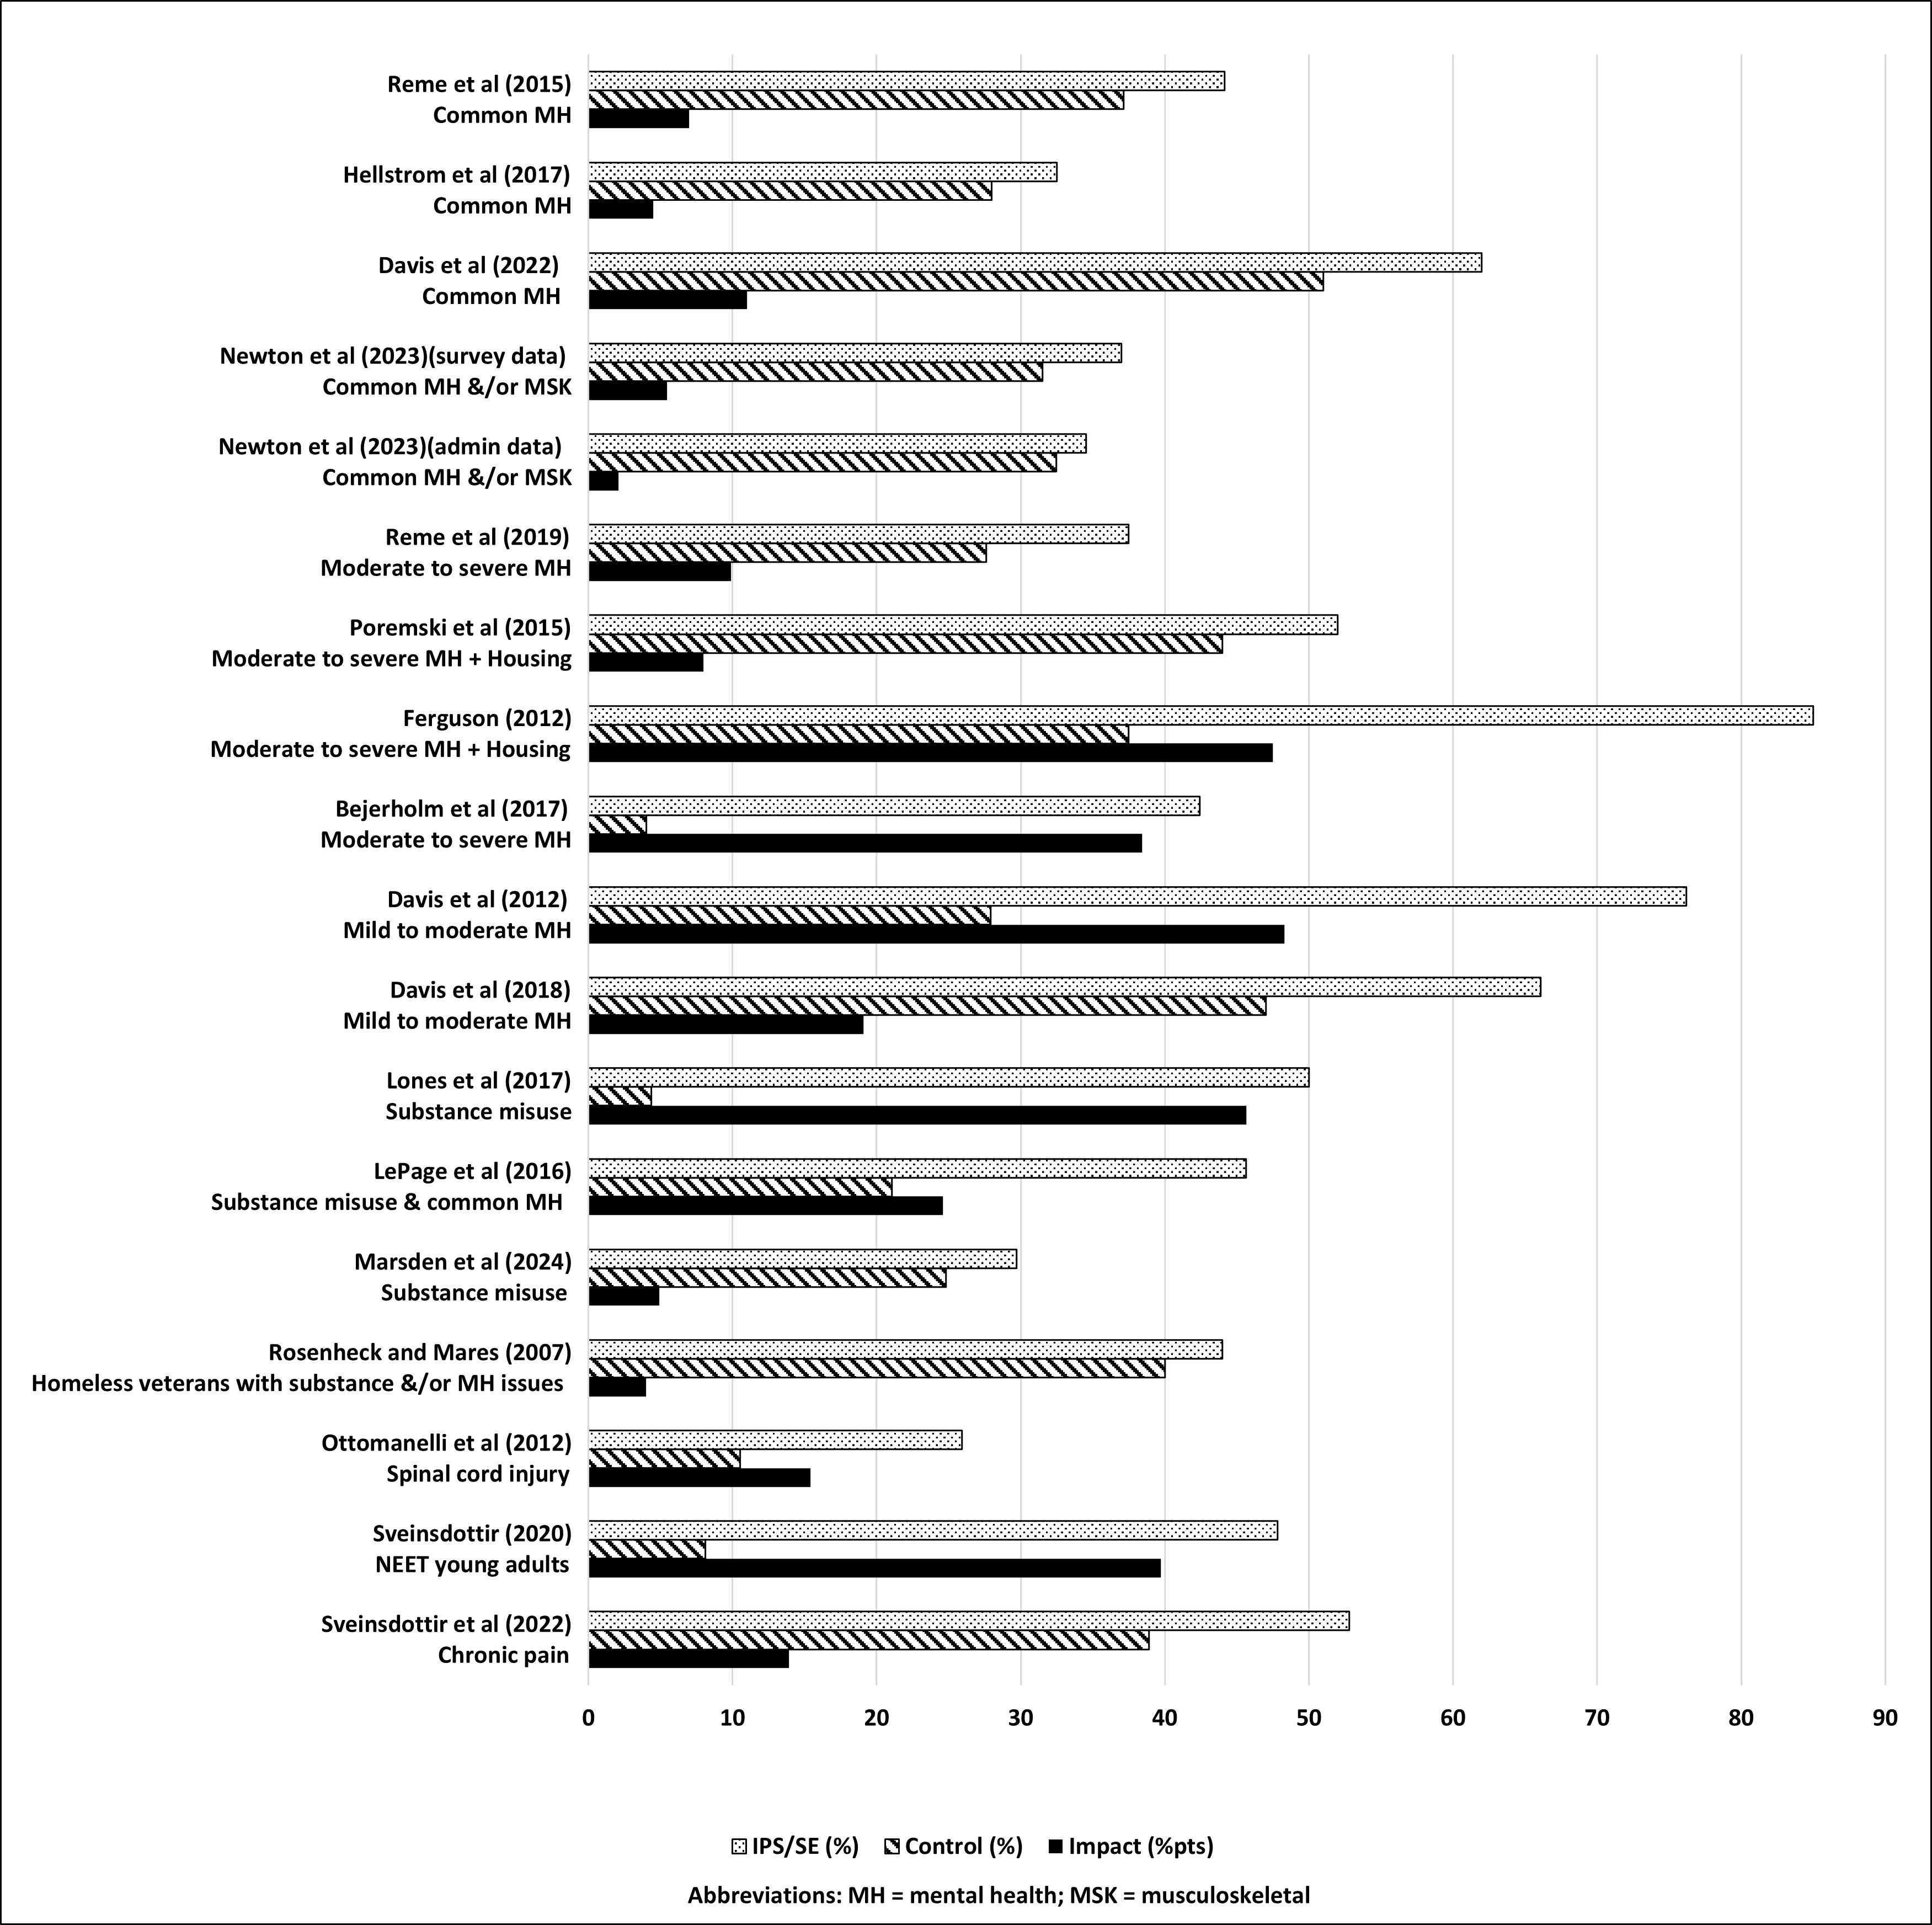
Job entry impact evidence

Slide 12
Job entry impact evidence
At 12m
At 12m
Within 12m for > 1wk
Within & at 12m / 13+ wks
Within & at 12m / 13+ wks
At 12m
Within 8m
Within 10m
At 12m
Within 12m
Within 12m
Within 6m
Within 6m
Within 18m
Within 24m
Within 12m
Within 12m
Within 12m
Brinchmann et al (2024): additional days only

Slide 13
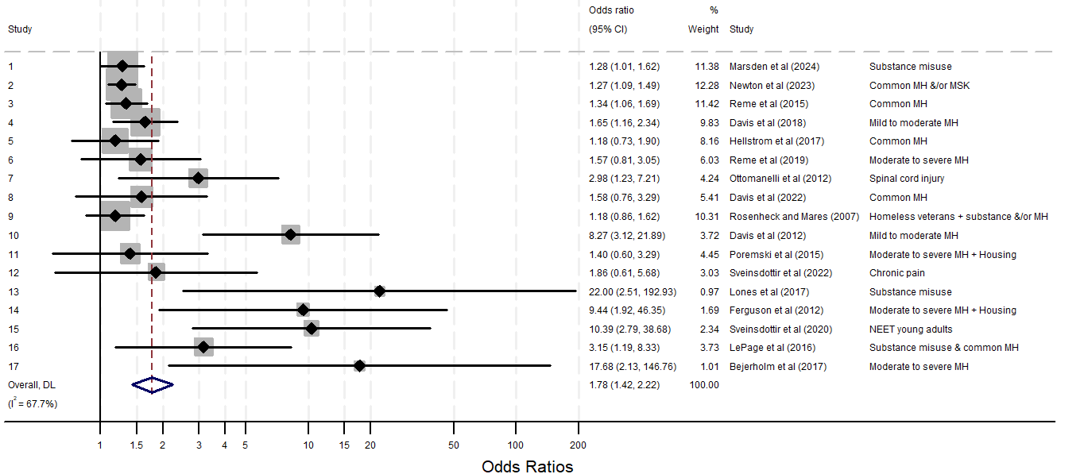
Meta-analysis of job entry impact evidence with all studies pooled
(lots of heterogeneity & small study effects)

Slide 14
Meta-analysis of job entry impact evidence with 3 study size sub-groups
(lots of heterogeneity and small study effects still amongst small studies, but not medium & large studies)

Slide 15
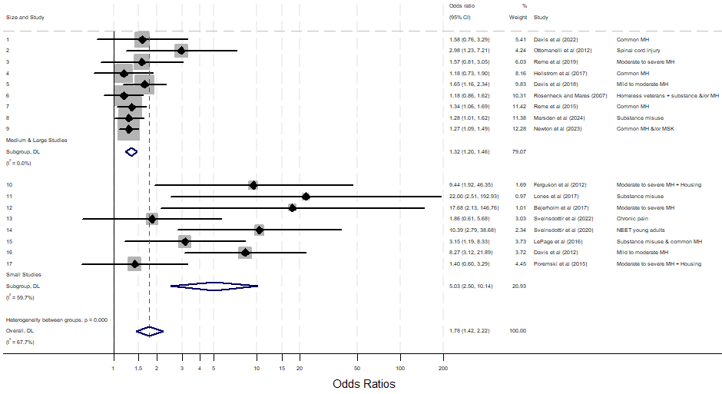
Meta-analysis of job entry impact evidence with 2 study size sub-groups
(this looks optimal, with the overall estimate of 1.32 [1.2,1.46] from the pooled medium & large studies suggested as appropriate measure for policy makers of expected average IPS effect for IPS at reasonable scale)

Slide 16
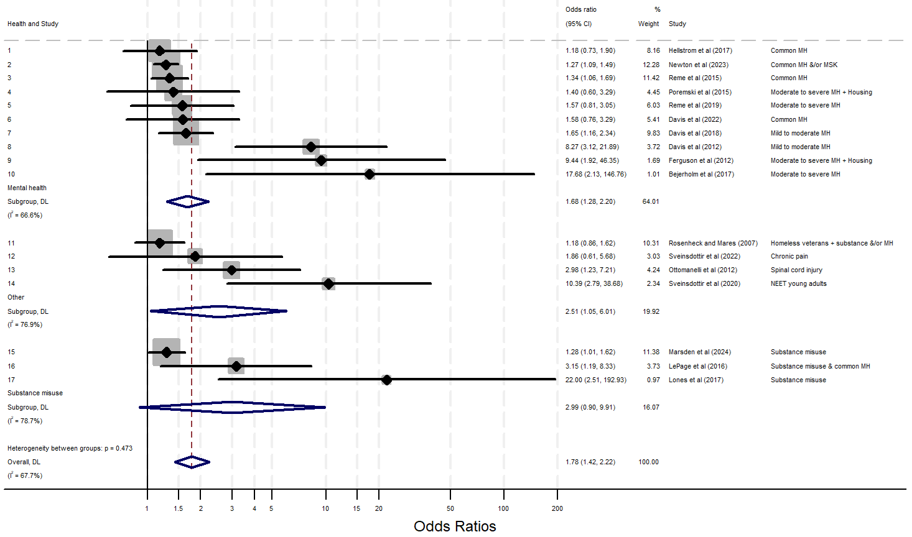
Meta-analysis of job entry impact evidence by health condition sub-groups, for interest
(not optimal, note heterogeneity within the sub-groups)

Slide 17
 |  |  | IPS / SEQF |  |  | Control
Study | Population | Definition | n | Mean / % | SD | n | Mean / % | SD | Sig | Ratio
Total work hours (Overall weighted ratio = 6.8)
LePage et al (2016) | Substance misuse and/or CMH | Total work hours over 6 month follow-up if employed | 46 | 266 | 254 | 38 | 217 | 176 | ns | 1.23
Bejerholm et al (2017) | Affective disorders | Total work hours within 12m follow-up (all participants) | 33 | 210.4 | 432.8 | 25 | 3.84 | 19.2 | 0.01 | 54.79
Davis et al (2012) | Mild to moderate mental health | Total work hours within 12m follow-up (all participants) | 42 | 656 | 661 | 43 | 236 | 494 | 0.00 | 2.78
Sveinsdottir et al (2020) | NEET young adults | Total work hours within 12m follow-up (all participants) | 43 | 140.0 | 249.4 | 37 | 13.95 | 55.48 | 0.00 | 10.04
Marsden et al (2024) | Substance misuse | Total days employed within 18m follow-up if employed | 207 | 132.6 | 141.6 | 175 | 130.4 | 137.3 | ns | 1.02
Brinchmann et al (2024) | CMH or somatic disorder | Average additional work days due to IPS per year per person | 561 | 5.6 | - | 3150 | 0 | - | 0.00 | -
Weekly hours worked (Overall weighted ratio = 7.1)
LePage et al (2016) | Substance misuse | Weekly work hours over 6 month follow-up if employed | 46 | 36 | 24 | 38 | 33 | 22 | ns | 1.09
Bejerholm et al (2017) | Affective disorders | Weekly hours at 12m follow-up (all participants) | 33 | 11.0 | 17.3 | 25 | 0.3 | 1.6 | 0.00 | 36.67
Sveinsdottir et al (2020) | NEET young adults | Percentage ever working >=20hrs per week during 12m follow-up (all participants) | 42 | 33.3 | - | 37 | 5.4 | - | 0.00 | 6.17
Ottomanelli et al (2012) | Spinal cord injury | Weekly hours during 12m follow-up if employed | 24 | 22.0 | 14.6 | 9 | 17.0 | 14.6 | <0.05 | 1.29
Poremski et al (2017) | Moderate to severe MH | Weekly hours if employed | 23 | 38.7 | - | 18 | 23.2 | - | 0.10 | 1.67
Ferguson et al (2012) | Moderate to severe mental health + housing issues | Weekly hours during the 10 month follow-up (all participants) | 16 | 33.4 | 3.95 | 20 | 32.5 | 10.6 | ns | 1.03
Sveinsdottir et al (2020) | Chronic pain | Percentage ever working >=20hrs per week during 12m follow-up (all participants) | 38 | 17.6 | - | 20 | 11.8 | - | 0.70 | 1.49
Ottomanelli et al (2014) | Spinal cord injury | Weekly hours worked if employed | 17 | 19.3 | 16.2 | 6 | 22.1 | 25.4 | - | 0.87
Job sustainment (Overall weighted ratio = 1.3)
LePage et al (2016) | Substance misuse | Days worked within 6 month follow-up if employed | 46 | 88.3 | 53.0 | 38 | 87.6 | 50.0 | ns | 1.01
Bejerholm et al (2007) | Affective disorders | Weeks worked within 12m follow-up (all participants) | 33 | 7.7 | 13.4 | 25 | 0.6 | 2.5 | 0.01 | 12.83
Davis et al (2012) | Veterans with PTSD | Total work days within 12m follow-up (all participants) | 42 | 83.8 | 80.6 | 43 | 29.3 | 61.9 | 0.00 | 2.86
Davis et al (2012) | Veterans with PTSD | Total work weeks within 12m follow-up (all participants) | 42 | 21.6 | 17.1 | 43 | 6.8 | 13.8 | 0.00 | 3.18
Ottomanelli et al (2012) | Spinal cord injury | Employment duration if employed (weeks) | 24 | 17.3 | 13.1 | 9 | 24.8 | 16.0 | <0.05 | 0.70
Poremski et al (2017) | Moderate to severe MH | Employment duration if employed (days) | 23 | 58 | - | 18 | 79 | - | 0.46 | 0.73
Hellstrom et al (2017) | Common mental health | Weeks worked within 12m follow-up (all participants) | 162 | 11.6 | 1.35 | 164 | 9.9 | 1.34 | 0.38 | 1.17
Hellstrom et al (2017) | Common mental health | Weeks worked within 24m follow-up (all participants) | 162 | 32.4 | 2.76 | 164 | 26.7 | 2.74 | 0.22 | 1.21
Davis et al (2022) | Common mental health | Days in paid work during 12m follow-up if employed | 36 | 177.0 | 61.9 | 31 | 123.3 | 82.8 | 0.00 | 1.44
Davis et al (2022) | Common mental health | Holding paid work for >=6m of the 12m follow-up | 58 | 45.0 | - | 61 | 25.0 | - | 0.02 | 1.80
Newton et al (2023) | Common MH &/or physical health | Weeks in paid employment during 12m follow-up | 1510 | 7.3 | 0.5 | 1380 | 7.1 | 0.5 | 0.77 | 1.03
Ferguson et al (2012) | Moderate to severe mental health + housing issues | Months worked during the 10 month follow-up (all participants) | 16 | 5.2 | 3.3 | 20 | 2.2 | 3.0 | 0.01 | 2.36
Davis et al (2018) | Mild to moderate mental health | Weeks employed during 18 month follow-up (all participants) | 271 | 17.5 | 17.7 | 270 | 12.1 | 15.5 | 0.00 | 1.45
Davis et al (2018) | Mild to moderate mental health | Days employed during 18 month follow-up (all participants) | 271 | 122.3 | 124.2 | 270 | 84.9 | 108.1 | 0.00 | 1.44
Lones et al (2017) | Substance misuse | Days worked during 12 month follow-up (if employed) | 11 | 177 | - | 5 | 156 | - | - | 1.13

Slide 18
 |  |  | IPS / SEQF |  |  | Control
Study | Population | Definition | n | Mean / % | SD | n | Mean / % | SD | p-value | Ratio
Rosenheck and Mares (2007) | Homeless veterans with substance misuse &/or moderate/severe MH | Days worked per month (all participants) | 321 | 8.8 | - | 308 | 5.6 | - | - | 1.57
Rosenheck and Mares (2007) | Homeless veterans with substance misuse &/or moderate/severe MH | Days worked during 24 month follow-up (all participants) | 321 | 34.1 | - | 308 | 29.8 | - | 0.04 | 1.14
Sveinsdottir et al (2022) | Chronic pain | Hours worked during 12 month follow-up (all participants) | 38 | 216.5 | 447.3 | 20 | 122.9 | 255.2 | 0.43 | 1.76
Marsden et al (2024) | Substance misuse | Longest employment spell within 18m follow-up if employed | 207 | 110.2 | 120.9 | 175 | 114.2 | 126.0 | ns | 0.96
Marsden et al (2024) | Substance misuse | Employed 13+ weeks in 18m follow-up if employed | 207 | 87 =42% | - | 175 | 73=42% | 41.7 | ns | 1.01
Overland et al (2018) | CMH | Employment no benefit for at least 24 of 36 months follow-up | 630 | 38.8 | - | 563 | 37.0 | - | 0.04 | 1.05
Ottomanelli et al (2014) | Spinal cord injury | Weeks in paid employment of 24 month follow-up if employed | 17 | 22.2 | 14.2 | 6 | 18.7 | 13.5 | - | 1.19
Wages/income earned (Overall weighted ratio = 1.1)
LePage et al (2016) | Substance misuse | Total wages over 6 month follow-up if employed ($) | 46 | 2,761 | 2,697 | 38 | 2,866 | 2,571 | ns | 0.96
Bejerholm et al (2017) | Affective disorders | Net income at 12m follow-up (Euros) (all participants) | 54 | 1,565 | - | 54 | 1,048 | - | 0.00 | 1.49
Davis et al (2012) | Veterans with PTSD | Total earned income in 12m follow-up ($) (all participants) | 42 | 9,264 | 13,294 | 43 | 2,601 | 6,009 | 0.00 | 3.56
Ottomanelli et al (2012) | Spinal cord injury | Weekly wages ($) if employed | 24 | 233.9 | 279.0 | 9 | 267.3 | 462.5 | <0.05 | 0.88
Davis et al (2022) | Common mental health | Earned income during 12m follow-up ($) if employed | 36 | 18,945 | 10,792 | 31 | 13,813 | 10,809 | 0.06 | 1.37
Newton et al (2023) | Mental &/or physical health | Earnings in month 12 post-randomisation (£) | 3,636 | 214 | 11 | 3,630 | 214 | 11 | 1.00 | 1.0
Ferguson et al (2012) | Moderate to severe mental health + housing issues | Weekly earned income during the 10 month follow-up ($)(all participants) | 16 | 263.6 | 147.6 | 20 | 192.5 | 116.7 | ns | 1.37
Davis et al (2018) | Mild to moderate mental health | Earned income during 18 month follow-up($)(all participants) | 271 | 14,642 | 19,308 | 270 | 10,989 | 17,097 | 0.00 | 1.33
Ottomanelli et al (2014) | Spinal cord injury | Earned wages per week in 24 month follow-up if employed ($) | 17 | 251.0 | 276.0 | 6 | 70.4 | 110.9 | - | 3.57
Hourly wage if employed (Overall weighted ratio = 1.0)
LePage et al (2016) | Substance misuse | Hourly wage over 6 month follow-up if employed ($) | 46 | 10.38 | - | 38 | 13.21 | - | ns | 0.79
Poremski et al (2017) | Moderate to severe mental health | Hourly wage if employed ($) | 23 | 16.82 | - | 18 | 13.19 | - | 0.34 | 1.28
Lones et al (2017) | Substance misuse | Hourly wage if employed ($) | 11 | 12.84 | - | 5 | 13.25 | - | - | 0.97
Rosenheck and Mares (2007) | Homeless veterans with substance misuse &/or moderate/severe MH | Hourly wage if employed ($) | 321 | 8.52 | - | 308 | 8.10 | - | - | 1.05
Mahwood and Howlin (1999) | Intellectual disabilities and autism spectrum disorder (ASD) | Hours wage if employed (£) | 19 | 5.71 | - | 5 | 4.14 | - | 0.02 | 1.38
Time to job entry/return to work (Overall weighted ratio = 1.4)
LePage et al (2016) | Substance misuse | Days to job entry/return to work | 46 | 130.7 | 63.6 | 38 | 157.1 | 50.1 | 0.02 | 1.20
Davis et al (2012) | Veterans with PTSD | Weeks to job entry (all participants) | Survival curve shows notably faster time to job entry of IPS group compared to control but no statistics are reported
Davis et al (2022) | Common mental health | Weeks to job entry | 58 | 8.7 | 8.8 | 61 | 17.1 | 14.2 | 0.00 | 1.96
Davis et al (2018) | Mild to moderate mental health | Weeks to job entry | 271 | 18.4 | 15.1 | 270 | 28.2 | 20.0 | 0.00 | 1.53
Marsden et al (2024) | Substance misuse | Time to first job if employed | 207 | 179.7 | 142.6 | 175 | 201.1 | 151.9 | ns | 1.12
Job search self-efficacy
Newton et al (2023) | CMH &/or physical health |  | 1445 | 3.2 | 0.0 | 1317 | 3.1 | 0.0 | 0.01 | 1.03
Job classification
Davis et al (2018) | Mild to moderate mental health | Hollingshead job classification % in occupational categories (1,2,3 / 4,5 / 6 / 7) | 276 | 20/45/ 55/29 | - | 211 | 19/50/ 37/31 | - | ns

Slide 19
Reflections on the quantitative evidence
There is a rapidly growing and already reasonably large evidence base around Supported Employment beyond SMI in diverse population groups. UK have contributed significantly to the international evidence base: let’s maximise analysis & insights
Several reviews identified but fragmented, inconsistent, partial and already dated coverage
Concentrated in certain countries and overwhelmingly IPS rather than SEQF
The impact evidence for IPS is consistently positive and frequently large in terms of: job entry; hours worked; job sustainment; time to job entry; total earned income. More mixed but generally positive findings around hourly wage
The evidence base is weakened by: small sample sizes; interventions not adhering to fidelity; testing IPS with other interventions; not always reporting fidelity; rapid job entry reporting given frequent fidelity strengthening; diverse job entry definitions; some studies with weak counterfactual designs; not always clear exactly what is inside BAU
Fidelity is key and takes time and attention to strengthen
Greater consistency, clarity and comprehensiveness of measurement and reporting of population groups/conditions and outcomes would aid understanding and comparability of the evidence

Slide 20
References
Bejerholm U, Larsson M, Johanson S. Supported employment adapted for people with affective disorders – a randomized controlled trial. Journal of Affective Disorders 2017:207
Bond G, Drake R, Pogue J. Expanding Individual Placement and Support to populations with conditions and disorders other than serious mental illness. Psych Serv 2019 70:6
Brinchmann, R., Witlund, S., Lorentzen, T., Moe, C., McDaid, D., Killackey, E., Rinaldi, M. and MyKletun, A. The societal impact of individual placement an support on employment outcomes for young people receiving temporary health-related welfare benefits: a differences-in-differences study. Psychological Medicine 2024 1-9
Davis L, Kyriakides T, Suris A, Ottomanelli L, Mueller L, Parker P, Resnick S, Toscano R, Scrymgeour A, Drake R. Effect of evidence-based Supported Employment vs transitional work on achieving steady work among veterans with posttraumatic stress disorder: A randomized clinical trial. JAMA Psych 2018 75:4
Davis L, Leon A, Toscano R, Drebing C, Ward L, Parker P, Kashner T, Drake R. A randomized controlled trial of Supported Employment among veterans with posttraumatic stress disorder. Psych Serv 2012 63:5
Davis L, Mumba M, Toscano R, Pilkinton P, Blansett C, McCall K, MacVicar D, Bartolucci A. A randomized controlled trial evaluating the effectiveness of Supported Employment integrated in primary care. Psych Serv 2022 73:6
Fadyl, J, Anstiss D, Reed K, Khoronzhevych M, Levack M. Effectiveness of vocational interventions for gaining paid work for people living with mild to moderate mental health conditions: systematic review and meta-analysis. BMJ Open 2020:10(e039699)
Ferguson K, Xie B, Glynn S. Adapting the Individual Placement and Support model with homeless young adults. Child & Youth Care Forum 2012 41
Harrison J, Krieger M, Johnson H. Review of Individual Placement and Support employment intervention for persons with substance use disorder. Subst Use and Misuse 2020 55:4
Hellstrom L, Bech P, Hjorthoj C, Nordentoft M, Lindschou J, Eplov L. Effect on return to work or education of Individual Placement and Support modified for people with mood and anxiety disorders: results of a randomised clinical trial. Occup and Env Med 2017 74
Jetha A, Shaw R, Sinden A, Mahood Q, Gignac M, McColl M, Ginis K. Work-focused interventions that promote the labour market transition of young adults with chronic disabling conditions: a systematic review. Occup and Env Med 2019:76
LePage J, Lewis A, Crawford A, Parish J, Ottomanelli L, Washington E, Cipher D. Incorporating Individualized Placement and Support principles into vocational rehabilitation for formerly incarcerated veterans. Psych Serv 2016 67
Lones C, Bond G, McGovern M, Carr K, Leckron-Myers T, Hartnett T, Becker D. Individual Placement and Support (IPS) for methadone maintenance therapy patients: a pilot randomized controlled trial. Admin and Policy in Mental Health 2017 44
Marsden, J., Anders, P., Shaw, C., Amasiatu, C., Collate, W., Eastwood, B., Horgan, P., Khetari, M., Knight, J., Knight, S., Melaugh, A., Clark, H. and Stannard, J. Superiority and cot-effectiveness of Individual Placeemnt and Support versus standard employment support for people with alcohol and drug dependence: a pragmatic, parallel-group, open-label, multicentre, randomised, controlled, phase 3 trial. The Lancet eClinicalMedicine. 2024;68: 102400
Newton B, Gloster R, Hofman J. Health-led employment trials evaluation: 12 months outcomes evidence synthesis. 2023 London: DWP & DHSC. Available at: https://www.employment-studies.co.uk/resource/health-led-trials-impact-evaluation-reports
Ottomanelli L, Goetz L, Barnett S, Njoh E, Dixon T, Holmes S, LePage J, Ota D, Sabharwal S, White K. Individual Placement and Support in spinal cord injury: A longitudinal observational study of employment outcomes. Arch of Phys Med and Rehab 2017 98:15
Ottomanelli L, Goetz L, Suris A, McGeough C, Sinnott P, Toscano R, Barnett S, Cipher D, Lind L, Dixon T, Holmes S, Kerrigan A, Thomas F. Effectiveness of Supported Employment for veterans with spinal cord injuries: results from a randomized multisite study Arch of Phys Med and Rehab 2012:93
Overland S, Grasdal A, Reme S. Long-term effects on income and sickness benefits after work-focused cognitive-behavioural therapy and individual job support. Occup and Env Med 2018 75:10
Poremski D, Rabouin D, Latimer E. A randomised controlled trial of evidence based Supported Employment for people who have recently been homeless and have a mental illness. Admin and Pol in Mental Health 2017 44
Probyn K, Engedahl M, Rajendran D, Pincus T, Naeem K, Mistry D, Underwood M, Froud R. The effects of supported employment interventions in populations of people with conditions other than severe mental health: a systematic review. Prim Health Care Res & Dev 2021:22(e79)
Reme S, Grasdal A, Lovvik C, Lie S, Overland S. Work-focused cognitive-behavioural therapy and individual job support to increase work participation in common mental disorders: a randomised controlled multicentre trial. Occup and Env Med 2015 72:10
Reme S, Monstad K, Fyhn T, Sveinsdottir V, Lovvik C, Lie S, Overland S. A randomized controlled multicenter trial of individual placement and support for patients with moderate-to-severe mental illness. Scand Jour of Work, Env & Health 2019 45:1
Rosenheck R, Mares A. Implementation of Supported Employment for homeless veterans with psychiatric or addiction disorders: two-year outcomes. Psychc Serv 2007 58:3
Sveinsdottir, V, Jacobsen H, Ljosaa T, Linnemorken L, Knutzen T, Ghiasvand R, Reme S. The Individual Placement and Support (IPS) in pain trial: A randomized controlled trial of IPS for patients with chronic pain conditions. Pain Med 2022 23:10
Sveinsdottir, V, Lie S, Bond G, Eriksen H, Tveito T, Grasdal A, Reme S. Individual placement and support for young adults as risk of early work disability (the SEED trial): a randomized controlled trial. Scand Jour of Work, Env & Health 2020 46:1

Slide 21

NIHR acknowledgement and disclaimer
This study/project is funded by the NIHR Policy Research Programme (PRP) (grant number NIHR202996). The views expressed are those of the author(s) and not necessarily those of the NIHR or the Department of Health and Social Care

